Slide 1
Time & Space Complexity in Java

Slide 2
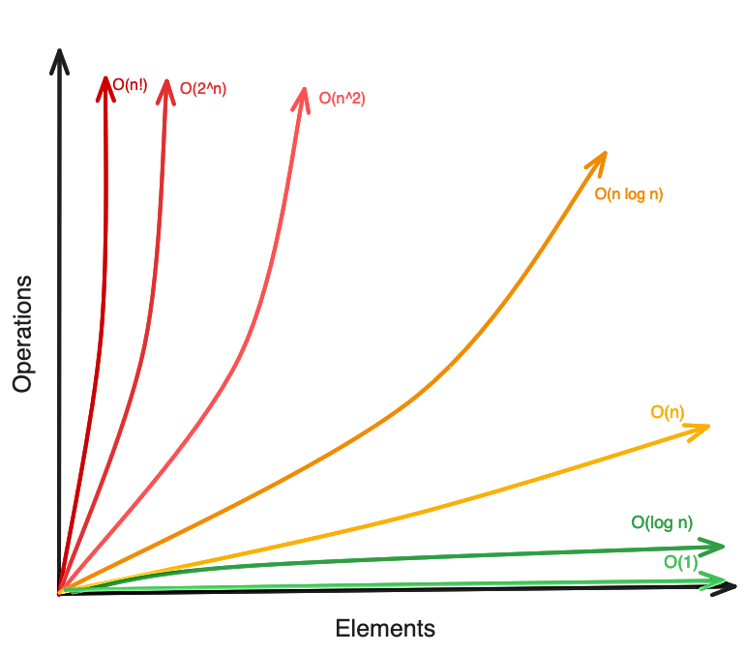
What is Time Complexity?
Time Complexity is how much time your code takes to run, depending on the size of the input.
You don’t count time in seconds or minutes.
You count how many operations the computer does.
Simple Example:
You're looking for your name in a list.
If the list has 5 names, you might find it quickly.
If the list has 5000 names, it takes longer.
The bigger the list, the longer it takes → This is Time Complexity.

Slide 3


Slide 4
How to Check Time Complexity?
How many times does the loop run?
Does the loop run inside another loop?
Do you divide the input each time?
Is the operation constant (doesn’t depend on input)?

Slide 5
Basic Time Complexities Explained One-by-One:
Notation | Name | Simple Meaning | Example
O(1) | Constant Time | Time doesn’t grow with input | Accessing arr[0]
O(log n) | Logarithmic Time | Input is divided each time | Binary Search
O(n) | Linear Time | Time grows with input | Loop through array
O(n log n) | Linearithmic Time | Fast sorting | Merge Sort, Quick Sort
O(n²) | Quadratic Time | Time grows a lot faster with input | Nested loops
O(2ⁿ) | Exponential Time | Very slow for large inputs | Recursive Fibonacci
O(n!) | Factorial Time | Extremely slow | Solving permutation problems

Slide 6

O(1) – Constant Time
Always runs in 1 step, no matter how big the array is.
Time Complexity: O(1)

Slide 7

O(n) – Linear Time
Runs n times
Time increases as input increases
Time Complexity: O(n)

Slide 8
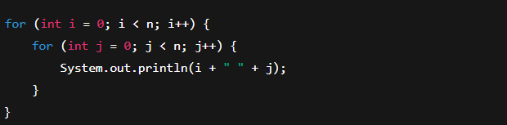
O(n²) – Quadratic Time
Nested loops
If n = 3, prints 9 times (3x3)
Time Complexity: O(n²)

Slide 9
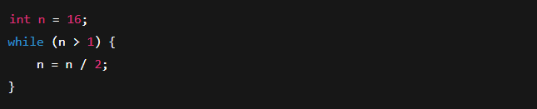
O(log n) – Logarithmic Time
Cuts input in half each time → very fast
If n = 16, steps = 4 (16→8→4→2→1)
Time Complexity: O(log n)

Slide 10
What Are Best, Worst, and Average Case in Time Complexity?
Case | Meaning
Best Case | The fastest the algorithm can finish
Worst Case | The slowest the algorithm can take
Average Case | The typical time on random input

Slide 11
Real-Life Example:
You're searching for a friend's name in a guest list:
Best Case: Their name is the first one → Found immediately.
Worst Case: Their name is the last one → Have to check every name.
Average Case: Their name is somewhere in the middle.

Slide 12
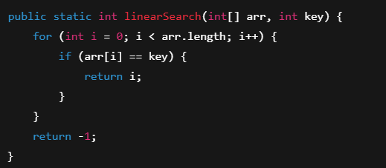
Example in Java: Linear Search
Let’s say arr = {2, 4, 6, 8, 10} and you're searching for key.
Best Case:
key = 2 (first item)
Only 1 check → Time Complexity = O(1)
Worst Case:
key = 10 (last item)
Must check every item → O(n)
Average Case:
key = 6 (middle or random)
On average, check about n/2 elements → But we write it as O(n)

